Slide 1

Procurement & Inventory Management

Slide 2
CONTENTS
Master Screens
Purchase Requisition Flow
Procurement Flow
Asset Management Flow
Asset Maintainence Flow

Slide 3
Masters
Item Group
Item
Item Price
Price List
Supplier Group
Supplier
Warehouse
Stock Setting
Cost Center
Tax Category
Tax Witholding Category
Terms & Conditions
Payment Term

Slide 4
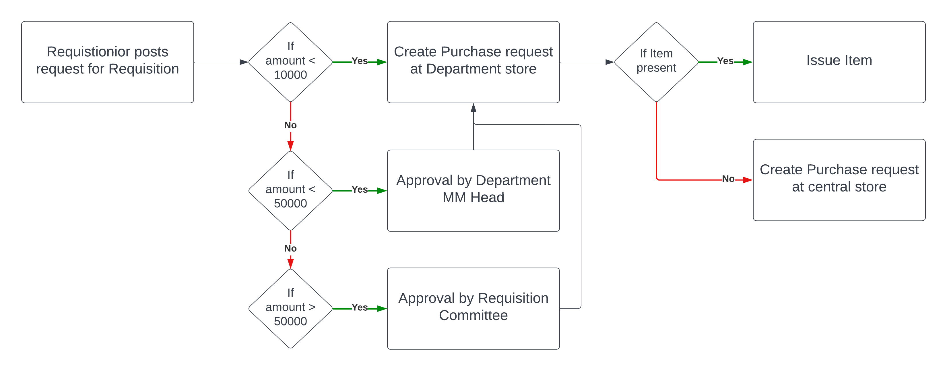
Purchasre Requisition flow- Internal

Slide 5
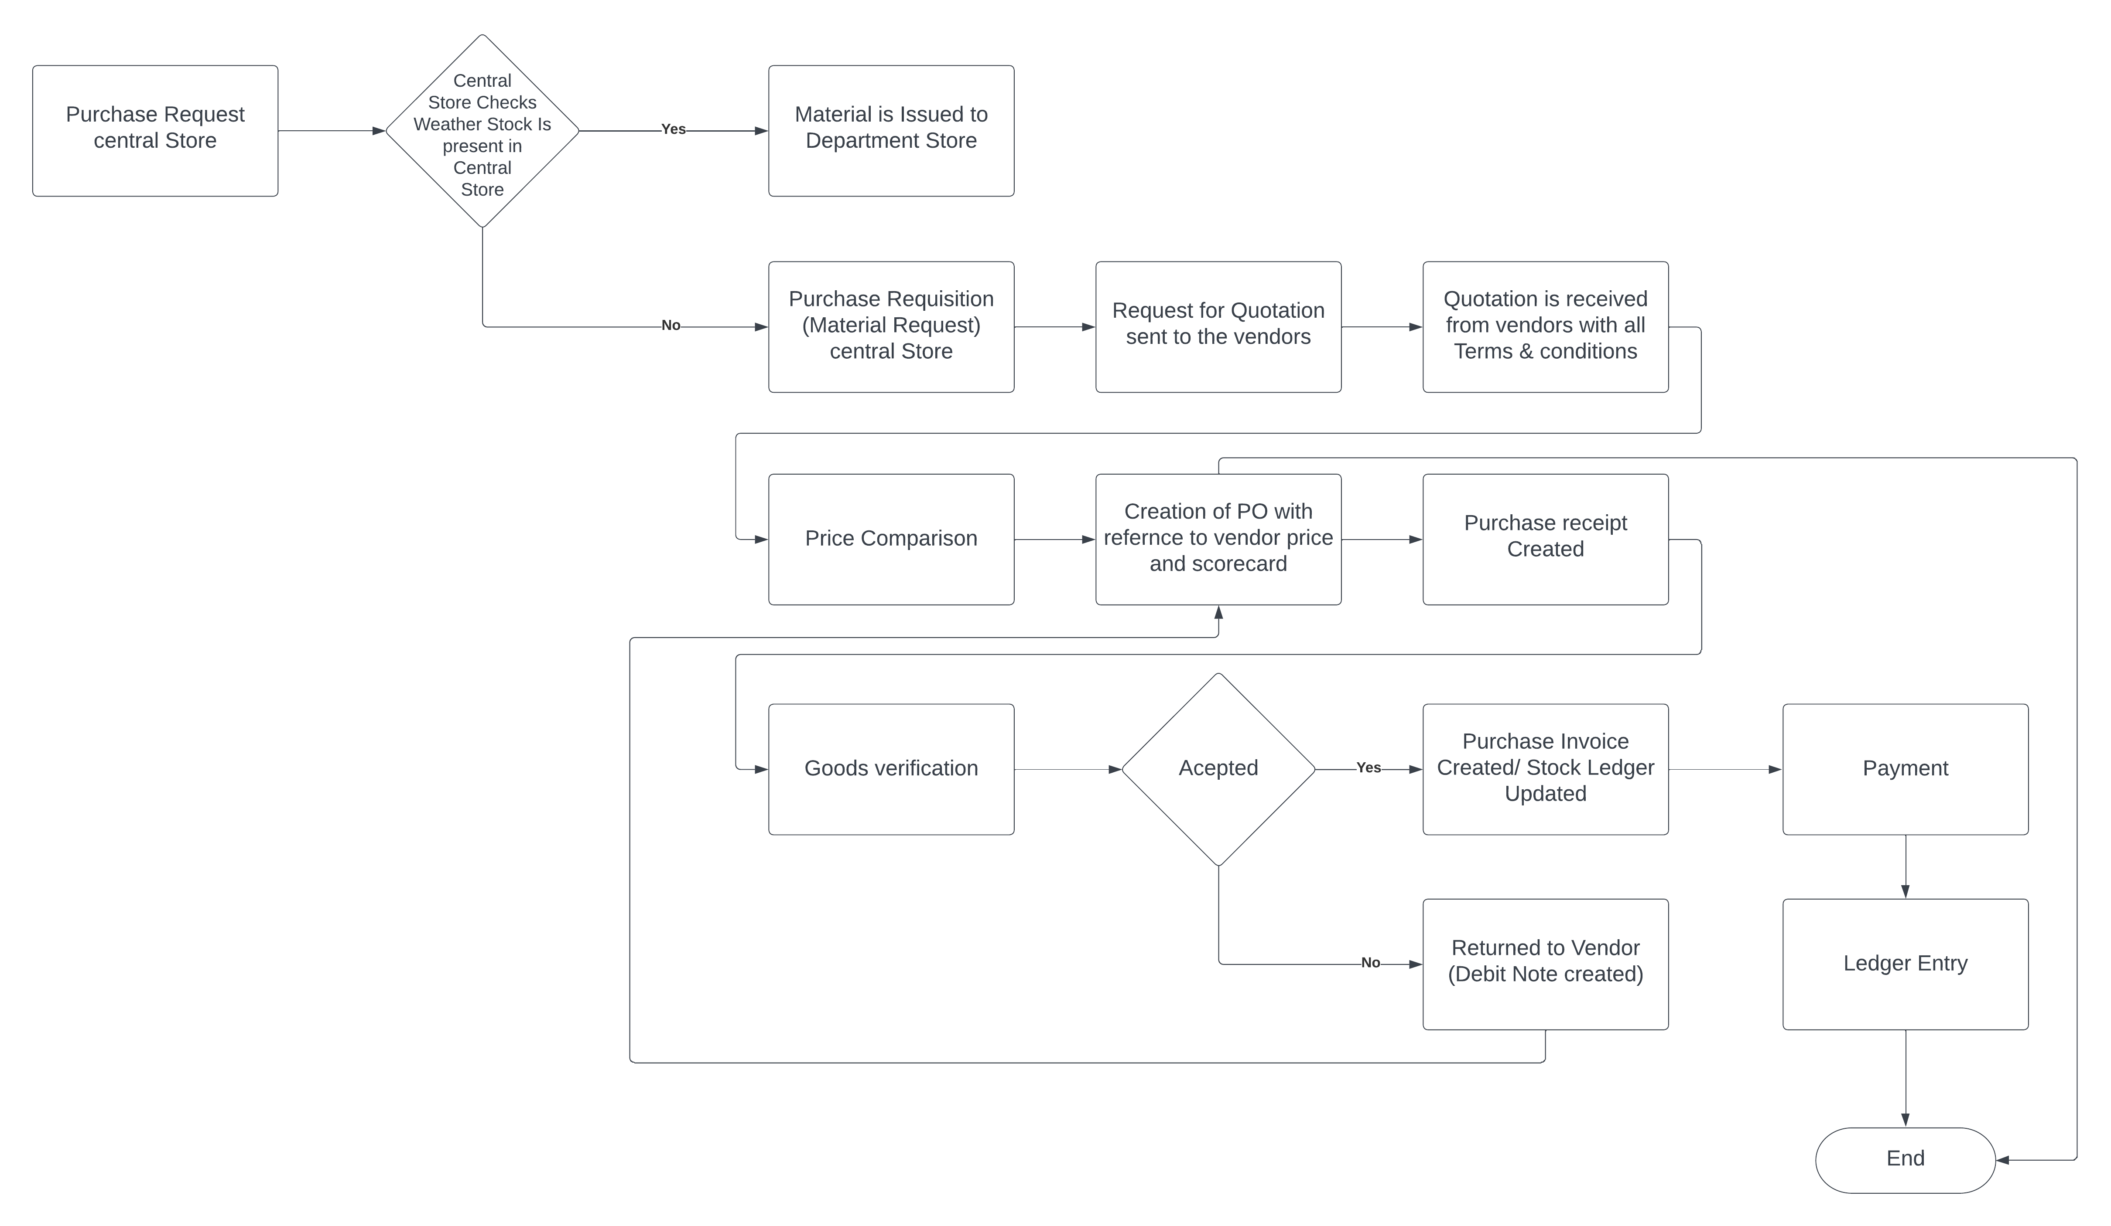
Procuremenent Flow

Slide 6
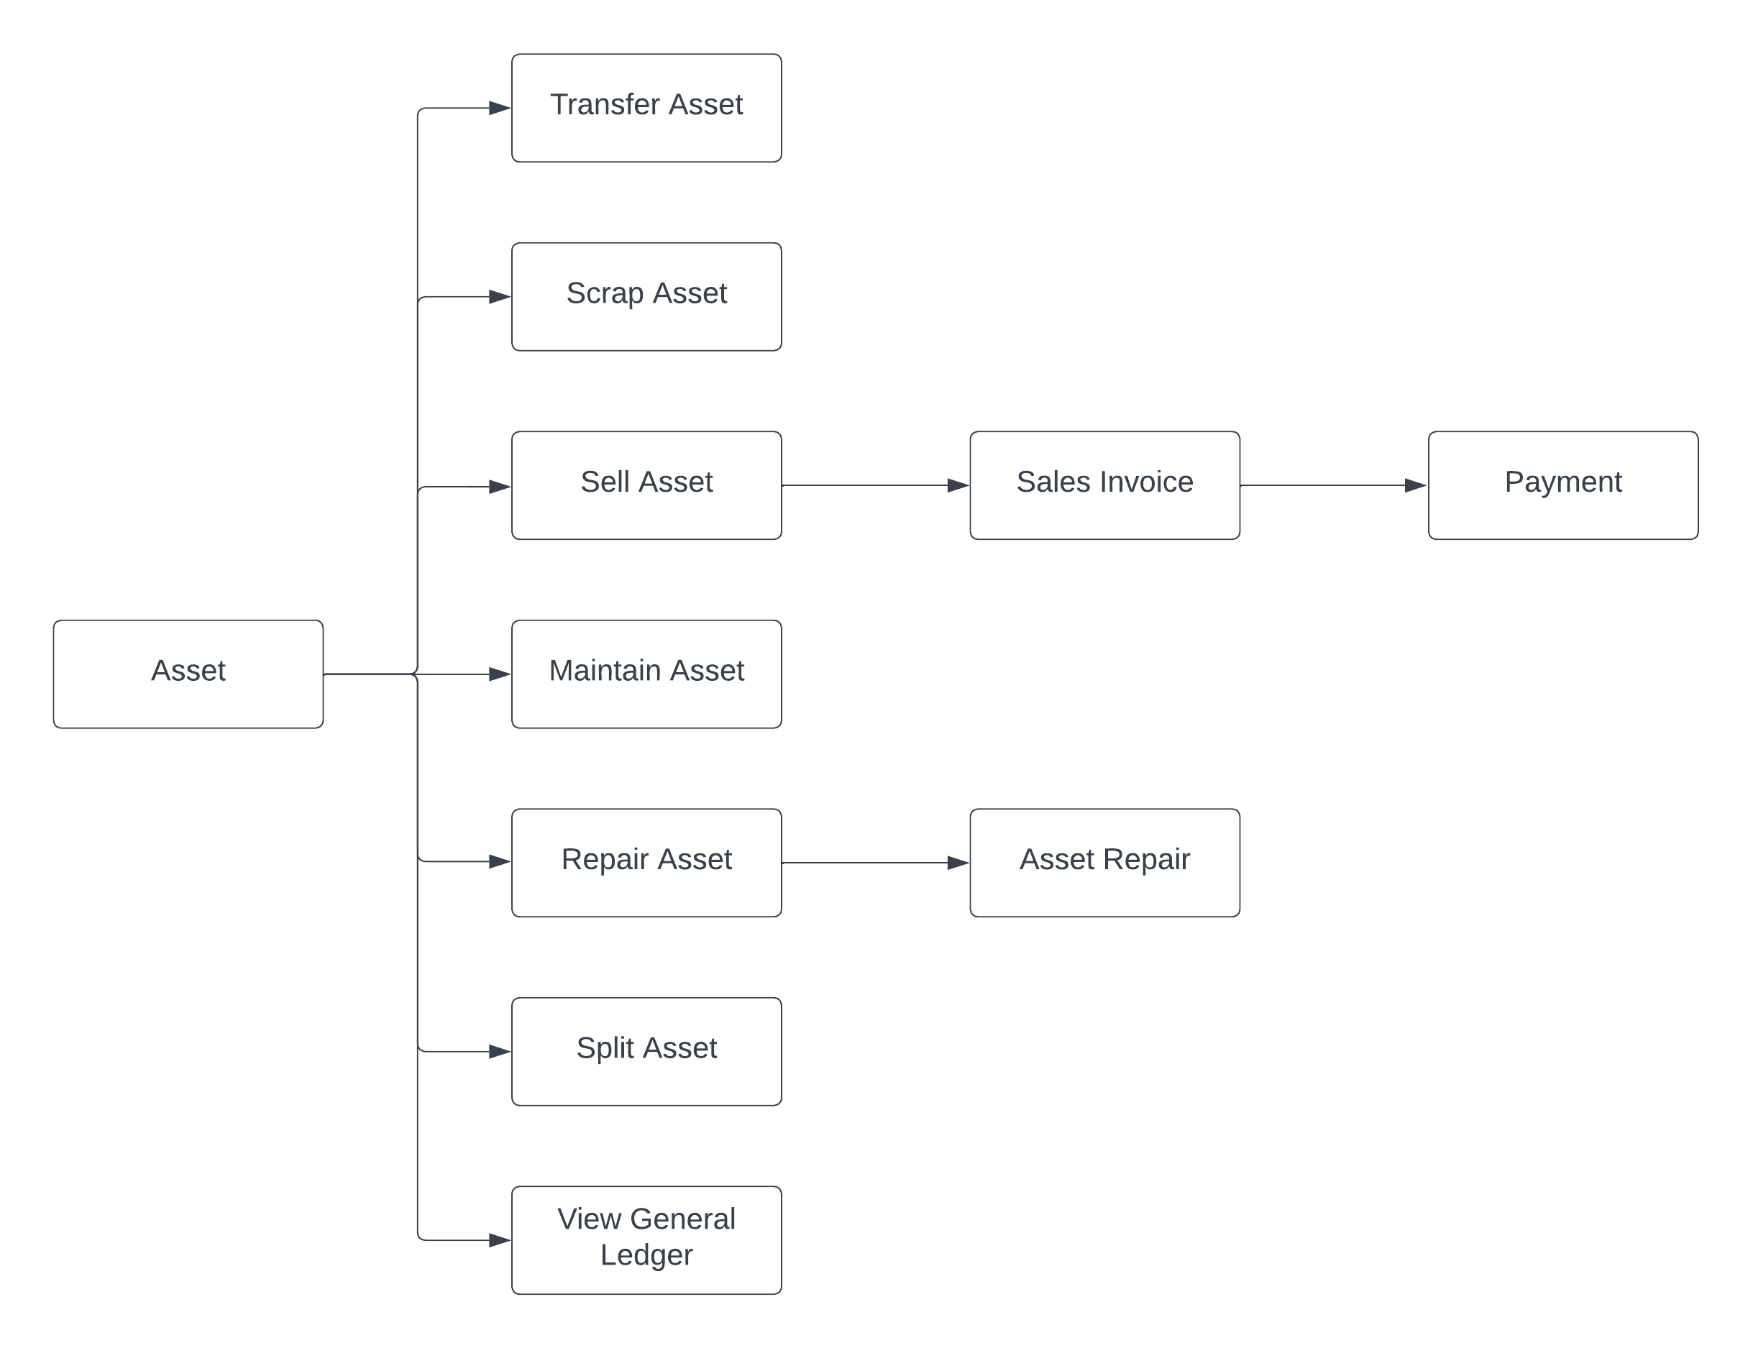
Asset Management Flow

Slide 7
Asset Maintainence Flow
Employee
Asset Maintenance Team
Asset Maintenance
Asset Maintenance Log
Asset Repair
General Ledger

Slide 8
THANK YOU

